Slide 1

Healthcare Analytics For Doctor Visits_TIRTC
Durga Prasad Annamdevula

Slide 2

PROBLEM STATEMENT
Healthcare organizations generate large amounts of information about doctor visits, patient appointments, diagnoses, treatments, and follow-up visits. Without proper analysis, it can be difficult to identify visit patterns, understand patient demand, monitor doctor workload, and improve healthcare services.
This project aims to analyze doctor visit data to identify meaningful patterns and trends that can support better healthcare planning and decision-making.

Slide 3
Project Description
Healthcare Analytics – Doctor Visits is a data analytics project designed to analyze doctor visit and appointment data. The project examines factors such as patient visits, doctor-wise workload, appointment trends, diagnoses, and other relevant healthcare attributes.
Using data preprocessing, exploratory data analysis, statistical analysis, and visualizations, the project identifies important patterns in doctor visits. The insights can help healthcare organizations understand patient demand, identify busy periods, monitor workload, and support effective resource and appointment planning.

Slide 4

WHO ARE THE END USERS?
Doctors – to understand patient visit patterns and workload.
Hospital Administrators – to monitor hospital and doctor performance.
Healthcare Managers – to plan resources and improve services.
Hospital Staff – to manage appointments and patient flow.
Healthcare Analysts – to analyze trends and generate insights.
Patients – indirectly benefit through improved appointment management and healthcare services.

Slide 5

Technology Used
  Python
  Pandas
  Numpy
  Matplotlib
  Seaborn
  Google colab

Slide 6
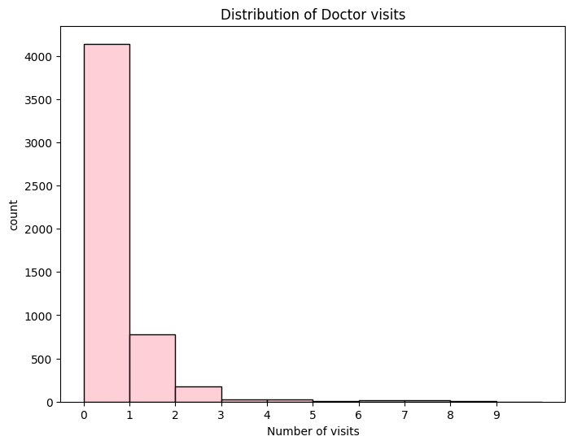

RESULTS
Demo Link

Slide 7
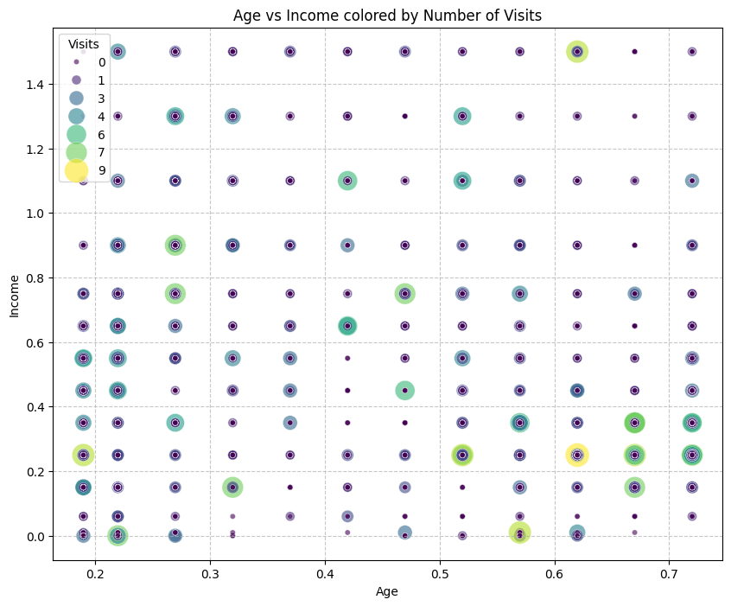
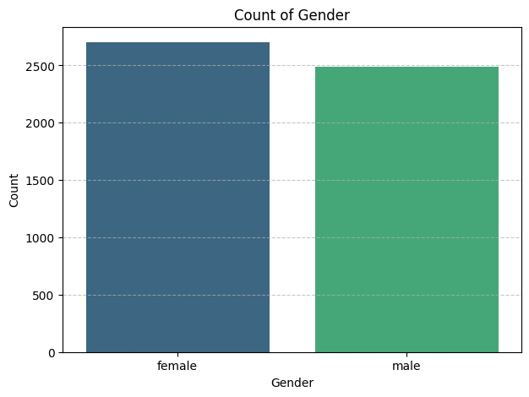
Demo Link: https://github.com/Annamdevula1/HealthCare-Analytics-For-Doctor-Visits.git

Slide 8
Thank you
.
.

